Slide 1
Sales Data Dashboard Design
A Visual Approach to Sales Performance

Slide 2
Introduction
Objective : To design a sales dashboard that effectively communicates key sales metrics and trends.
Key Features : Real-time data, user-friendly interface, actionable insights.

Slide 3
Importance of a Sales Dashboard
Key Benefits:
Real-time monitoring of sales performance.
Easy comparison of targets vs. actuals.
Identifying trends and anomalies.
Data-driven decision-making.

Slide 4
Core Metrics to Include
Total Sales : Overview of revenue generated.
Sales by Region/Category : Breakdown for better segmentation.
Sales Growth : Percentage increase/decreace.
Top Products : Best-performing items.
Conversion Rate : Sales efficiency.
Sales Forecast : Predictive analysis for future sales.

Slide 5
Dashboard Layout Design
Visual Hierarchy :
Top Section : key metrices(total sales , growth).
Middle Section : Breakdown(Sales by Region, Top products).
Bottom Section : Graphical trends(Sales Growth, Forecast)

Slide 6
Data Visualization Techniques
Charts & Graphs :
Bar Charts : For category-wise comparisons
Line Graphs : To show sales trends over time
Pie Charts : For Regional breakdowns
KPIs/Indicatore : For total sales, growth, and targets

Slide 7
User-Friendly Design
Consistency : Uniform colors, fonts, and icons.
Interactivity : Filters to drill down into data
Clarity : Avoid clutter, keep visuals simple and to the point.

Slide 8
Tools for Building the Dashboard
Popular Tools :
Power BI
Tableau
Excel
Google Data Studio

Slide 9
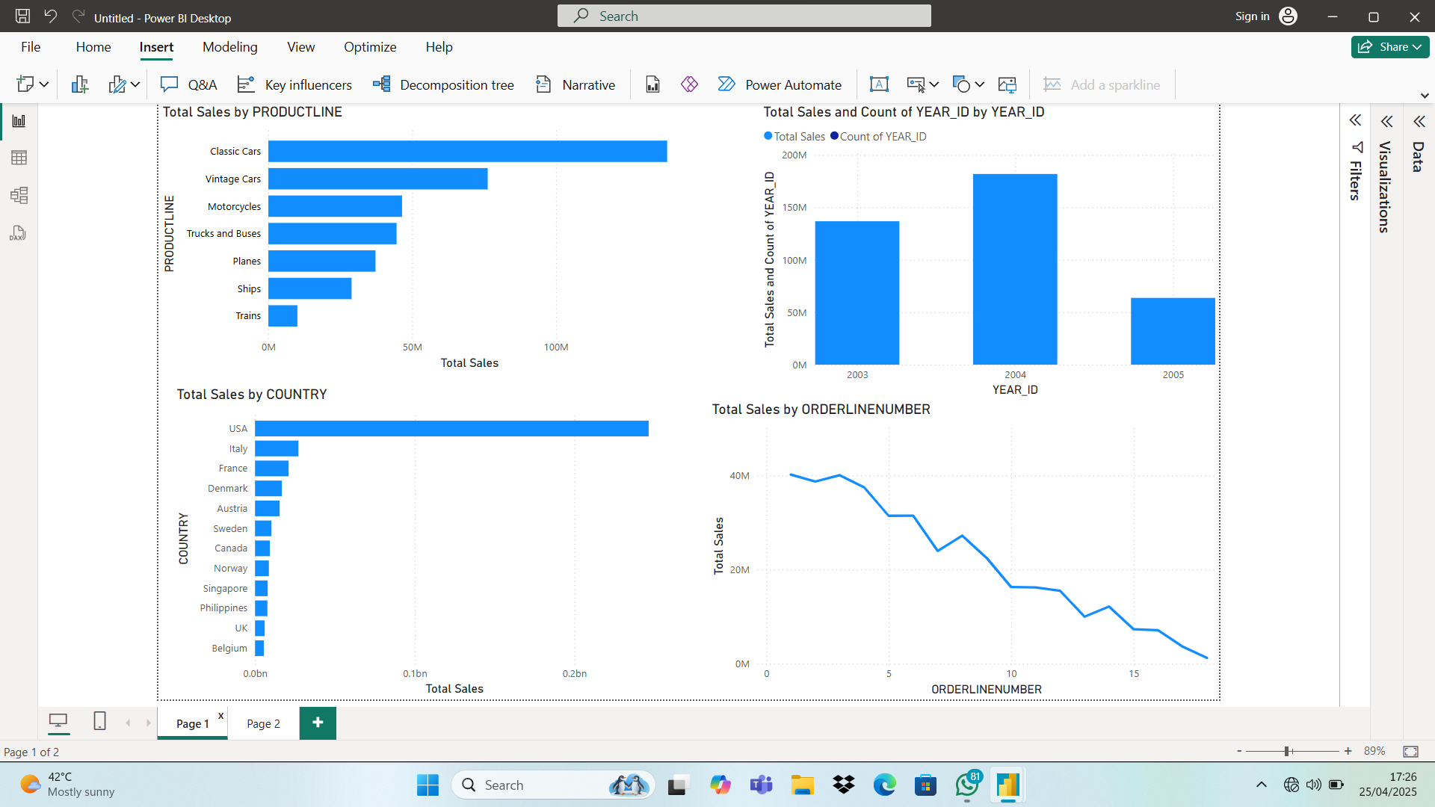
Dashboard output

Slide 10
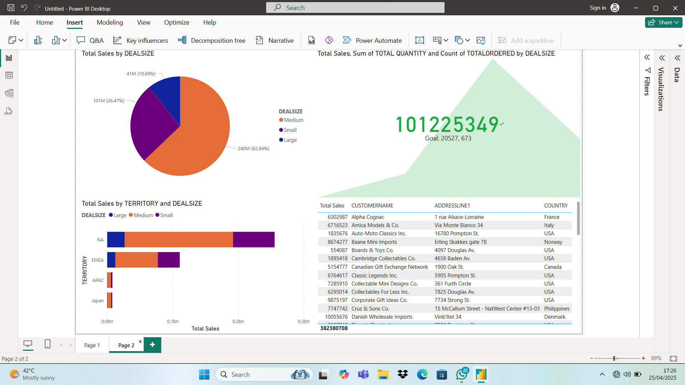
Sheet 2

Slide 11
Conclusion
A well-designed dashboard is crucial for quick, informed decision-making.
Regular updates and user feedback are key to enhancing the dashboard.

